Slide 1


CS 6831 Designing Secure Cryptography
Tom Ristenpart

Slide 2
Asymmetric crypto so far
RSA
Work in Z_{N} for large composite N = pq
RSA assumption: given Xe mod N can’t recover X without secret key d
Discrete log problem (DLP)
Work in prime-order subgroup of Z_{p} for prime p. g is a generator of subgroup. q is size of subgroup
Discrete log assumption: given g^{x} mod p can’t recover x
Elliptic curves
Work in groups consisting of solutions to elliptic curve equations
Discrete log style
Can equip some with bilinear pairings
Today: lattice-based crypto
*
*

Slide 3
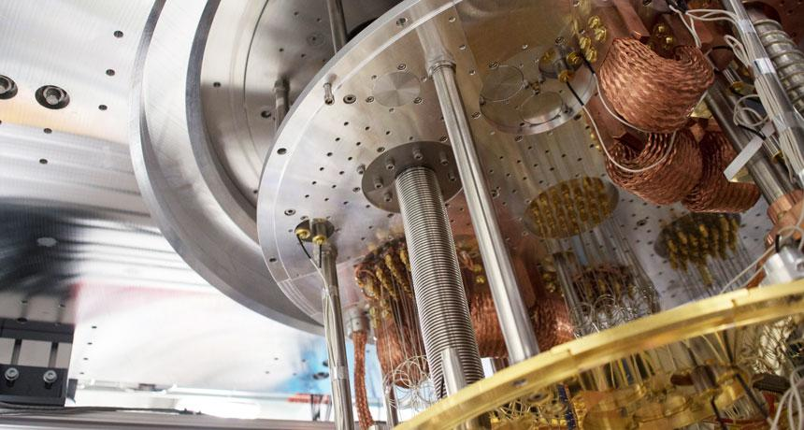
The oft-heard motivation

Slide 4
Two important quantum algorithms
[Shor 1994] factors composite number N
Recall, fastest algorithm we can implement is NFS. Runs in time
Shor’s algorithm gives solution using quantum circuit of size
Can be used to compute discrete logs as well
[Grover 1996] inverts functions with quadratic speedup
Uses to recover K from E_{K}(0^{n}), for |K| = k bits
Double key lengths: AES-256 all good

Slide 5
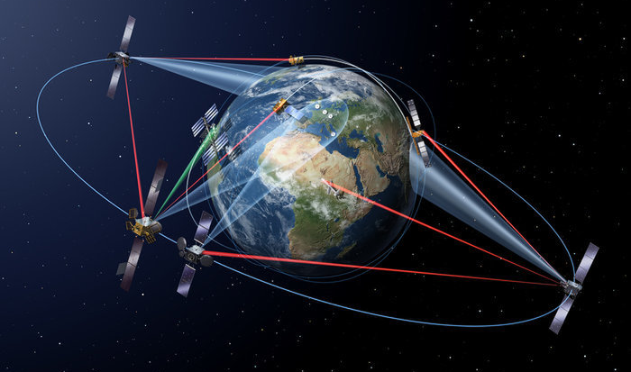
Cryptopoclypse?
“Post-quantum crypto” (PQC)
Asymmetric algorithms with conjectured security against QCs
Hash-based signatures, lattice-based, code-based, non-linear systems of equations, elliptic curve isogenies
Gaining practical momentum:
NIST competition, practical variants of TLS key exchange
Quantum key distribution
Interesting concept, but turned into snake oil
Run away!

Slide 6
Cryptopoclypse?
Why are people excited about this now?
Quantum computers are getting realer (lots of $$$ thrown at it)
Traffic encrypted now under possibly future-vulnerable algorithms
Evan Jeffrey’s (Google’s QC team) at RWC 2017:
Factoring 2048-bit RSA: 250,000,000 physical q-bits with 99.9% accuracy
State-of-the-art QC: 9 physical q-bits with 99.5% accuracy
Classical attacks may invalidate existing algorithms (including PQC!!!)
“Classical algorithms will break NIST PQC winner before QCs break ECC”
- Professor procrastinating from lecture prep by making offhand conjectures

Slide 7
New asymmetric crypto is cool even forgetting about QCs
Having diverse set of assumptions good
Raises lots of questions about cryptographic agility
How do we guarantee we can move to other schemes when others are broken? Etc.
Provide algebraic structure that’s been useful for new theory
Fully-homomorphic encryption

Slide 8

Lattices
Lattices defined using basis b₁, … , b_{m} each in
Then is additive subgroup of
Crypto uses full rank lattices: m = n
Examples in n=2
Basis not unique!

Slide 9
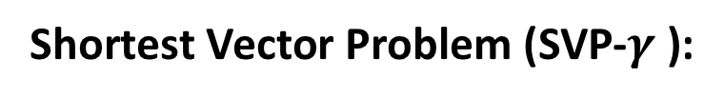
Lattices
Lattices defined using basis b₁, … , b_{n} each in
Shortest vector in a lattice:
Shortest Vector Problem (SVP-$γ$ ):
Given:
Compute such that

Slide 10




SVP-$γ$
Diagram from: http://web.eecs.umich.edu/~cpeikert/pubs/slides-abit1.pdf

Slide 11
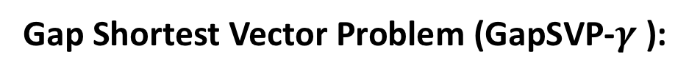
Lattices
Lattices defined using basis b₁, … , b_{n} each in
Shortest vector in a lattice:
Shortest Vector Problem (SVP-$γ$ ):
Given:
Compute such that
Gap Shortest Vector Problem (GapSVP-$γ$ ):
Determine if:
Given:
or

Slide 12





GapSVP-$γ$
Diagram from: http://web.eecs.umich.edu/~cpeikert/pubs/slides-abit1.pdf

Slide 13
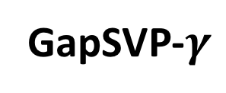
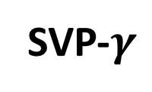

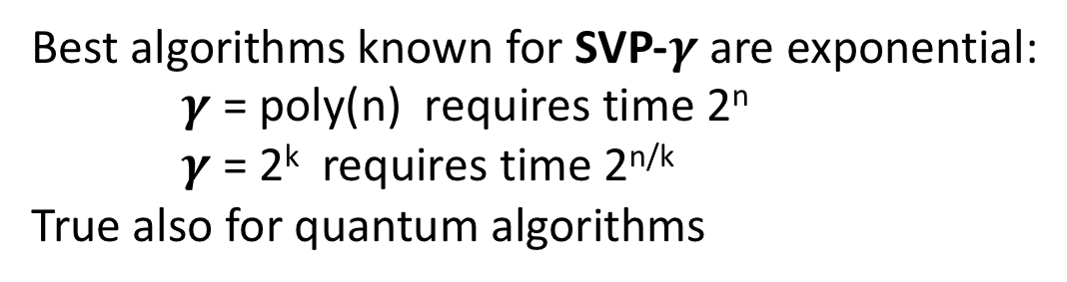
What is known about these problems?
SVP-$γ$
GapSVP-$γ$
Diagram from: http://web.eecs.umich.edu/~cpeikert/pubs/slides-abit1.pdf
Best algorithms known for SVP-$γ$are exponential:
$γ$ = poly(n) requires time 2^{n}
$γ$ = 2^{k} requires time 2^{n/k}
True also for quantum algorithms
Don’t build cryptosystems directly from SVP problems
Instead:
Assumptions reducible to (Gap)SVP

Slide 14
What is known about these problems?
SVP-$γ$
GapSVP-$γ$
Diagram from: http://web.eecs.umich.edu/~cpeikert/pubs/slides-abit1.pdf
[Ajtai 96]: solving SVP on

Slide 15
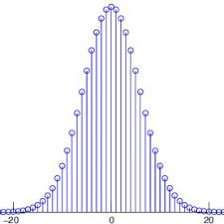
Learning with errors (LWE)
Let
be secret vector
All values integers mod q!
Let
be random m x n matrix
Errors taken from “bounded” distribution
(w.h.p. very small!)
Discrete Gaussian:
Let
be “noise” vector
Given:
Compute:
System of m linear equations with n+m unknowns
+
=

Slide 16
Learning with errors (LWE)
System of m linear equations with n+m unknowns
=
-
If errors are uniform over Z_{q} then finding s impossible
If error removed, sequence of m equations in n unknowns.
When m >= n, solvable via Gaussian elimination
Adding a bit of noise messes up Gaussian elimination
Error “adds up” when doing linear combinations of the equations

Slide 17
Learning with errors (LWE)
Let
be secret vector
All values integers mod q!
Let
be random m x n matrix
Errors taken from “bounded” distribution
(w.h.p. very small!)
Discrete Gaussian:
Let
be “noise” vector
(Search
problem)
Given:
Compute:
Given:
(Decision
problem)
Determine b
Surprising fact: decision reducible to search problem, for same m,n,q,$χ$!

Slide 18
What is connection between LWE and lattices?
Worst-case hardness of GapSVP implies LWE (for certain ranges of parameters)
Diagrams from http://web.eecs.umich.edu/~cpeikert/pubs/slides-abit2.pdf

Slide 19
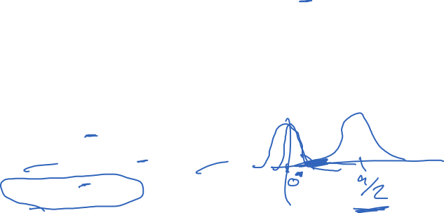
Regev’s encryption scheme from LWE
Builds PKE for single bit messages that tightly reduces to (decisional) LWE
Encrypt bit m via:
sk =
pk =
=
A public, random m x n matrix, can be reused for keys
Decrypt via:
If m’ closer to q/2 then Return m = 1
If m’ closer to 0 then Return m = 0
When does it work?
Should be smaller than q/4 Choose Gaussian appropriately

Slide 20

Regev’s encryption scheme from LWE
Builds PKE for single bit messages that tightly reduces to (decisional) LWE
Encrypt bit m via:
sk =
pk =
=
Security? Adversary knows: pk, A, c₁, c₂ must determine m.
Recall LWE assumptions:
(Search
problem)
Given:
Compute:
(Decision
problem)
Given:
Determine b

Slide 21
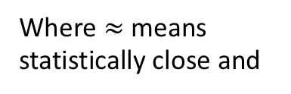

Regev’s encryption scheme from LWE
Builds PKE for single bit messages that tightly reduces to (decisional) LWE
Encrypt bit m via:
sk =
pk =
=
Security? Adversary knows: pk, A, c₁, c₂ must determine m.
Sketch of reduction to decision LWE
Replace pk with uniform random vector Z, via easy reduction to decision LWE
Use “leftover hash lemma” to show that
Since r₂ independent of all else, perfectly hides message m
Where $≈$ means statistically close and

Slide 22
Towards practical schemes
Regev’s scheme not yet practical
Public-key’s size O(n²) and ciphertexts O(n) elements of Z_{q}
Encrypts one bit at a time
Ring-LWE by [Lyubashevsky, Peikert, Regev 2010]
LWE but over ring of polynomials over finite field
Big efficiency improvements: encrypt n-bit message all at once

Slide 23
NIST competition
Goal to standardize PQC systems (signatures and encryption)
Example:
NewHope-KEM concretizes LPR Ring-LWE approach
Sizes in bytes, https://newhopecrypto.org/data/NewHope_2018_06_14.pdf

Slide 24
Efficiency comparison
Security level | RSA (log N) | DLP in ECC groups
80 | 1024 | 160
112 | 2048 | 224
128 | 3072 | 256
256 | 15360 | 512
Security level (QC bit strength) | NewHope |pk| | NewHope |ctxt|
101 | 7424 | 8704
233 | 14592 | 17408

Slide 25
NIST competition
Goal to standardize PQC systems (signatures and encryption)
Example:
NewHope-KEM concretizes LPR Ring-LWE approach
Use cryptographic combiner approach, combined ECC DH + NewHope key exchange

Slide 27
Lattices
Lattices defined using basis b₁, … , b_{n} each in
Shortest vector in a lattice:
Where
is m x n matrix for any basis of
(one can show that all such bases have same det)
Minkowski’s theorem:
Gap Shortest Vector Problem (GapSVP-$γ$ ):
Given:
Determine if:
or

